Slide 1
Impact of COVID-19 on Work Habit, Stress Level A Statistical Analysis
Name: Jyoti Dave
Master Of Science, Data Science
Bellevue University
DSC530 Data Exploration and Analysis
Prof. Matthew Metzger
Feb 28, 2025

Slide 2
Introduction
Statistical Question:
The COVID-19 pandemic forced an unprecedented shift in how people work, especially with the rapid adoption of remote work and the changing dynamics of workplace responsibilities.
This shift raised several critical questions:
1. How did stress levels change during the COVID-19 pandemic across different groups (work from office people, work from home people, etc.)?
2. What factors (e.g., hours worked per day from office or home, team collaboration challenges, professional in which sector) had the greatest impact on individuals’ stress levels?
3. Is there a correlation between work from home and job security?
4. How many had the insecurities in their job due to COVID-19?
5. How many hours the work needed to be done when working from home? Did that increase the stress level?

Slide 3
Introduction
Statistical Question:
This project seeks to address these questions by analyzing a dataset that captures various work-related
factors impacted by the pandemic
The goal is to understand the relationship between work-from-home conditions, increased work hours, and
other factors such as stress, productivity changes, and team collaboration challenges.
Specifically, I aim to identify how remote work and increased work hours have influenced productivity and stress levels.
Assess how different industries have been affected and whether certain sectors experienced unique challenges.
Determine the extent to which factors like childcare responsibilities, health issues, and technology adaptation
have influenced employee experiences. Provide insights that can inform future workplace policies to support employee well-being and efficiency.
Ultimately, this analysis will help organizations and policymakers better understand the pandemic’s impact

Slide 4
Dataset Overview
Dependent Variable: Hours Worked Per Day
Independent Variables: Stress Level, Productivity Change, Health Issues, Job Security, Technology Adaptation
Sample Size: 10,000 respondents from various sectors (e.g., IT, Retail, Education)
Hours_Worked_Per_Day (Continuous) → Measures workload changes and potential stress impacts.
Stress_Level (Categorical: Low, Medium, High) → Assesses stress as a function of work changes.
Productivity_Change (Binary: 1 = Increase, 0 = No change/Decrease) → Examines factors affecting productivity shifts.
Health_Issue:Type: (Binary: 1 = Yes, 0 = No) → Indicates if the individual has developed new health issues (mental or physical) during the pandemic.
Job_Security: (Binary: 1 = Yes, 0 = No) → Perception of job security during the pandemic, with 1 indicating feeling less secure.
Technology_Adaptation: (Binary: 1 = Yes, 0 = No) → Whether the individual had to adapt to new technologies for remote work.
Work_From_Home (Binary: 1 = Yes, 0 = No) → Helps analyze differences in productivity, stress, or work hours between remote and on-site workers.
Salary_Changes (Binary: 1 = Increase, 0 = No change/Decrease) → Explores financial stability’s impact on stress and productivity.

Slide 5
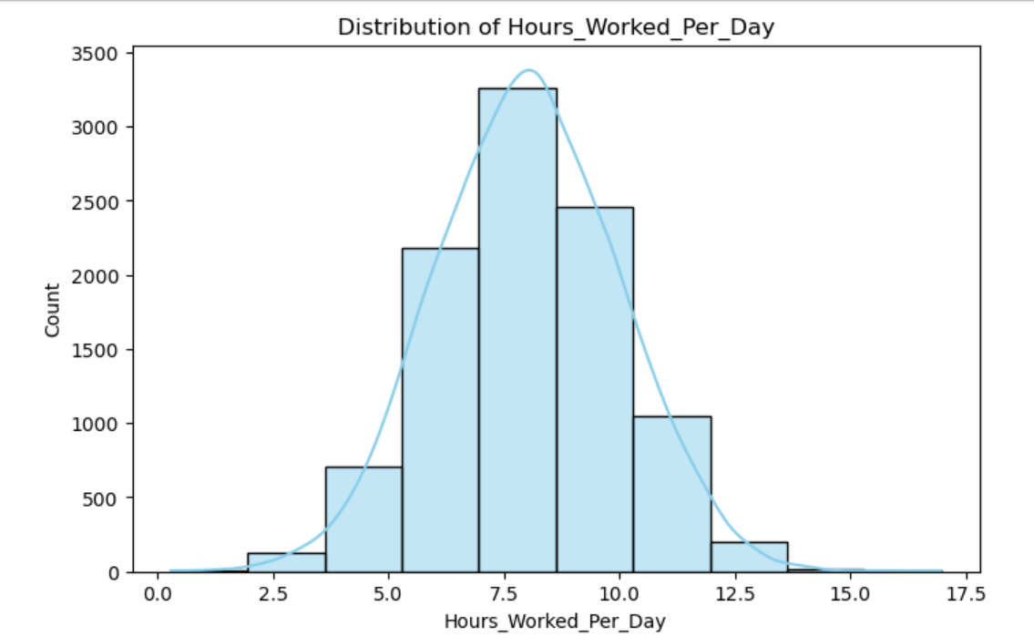
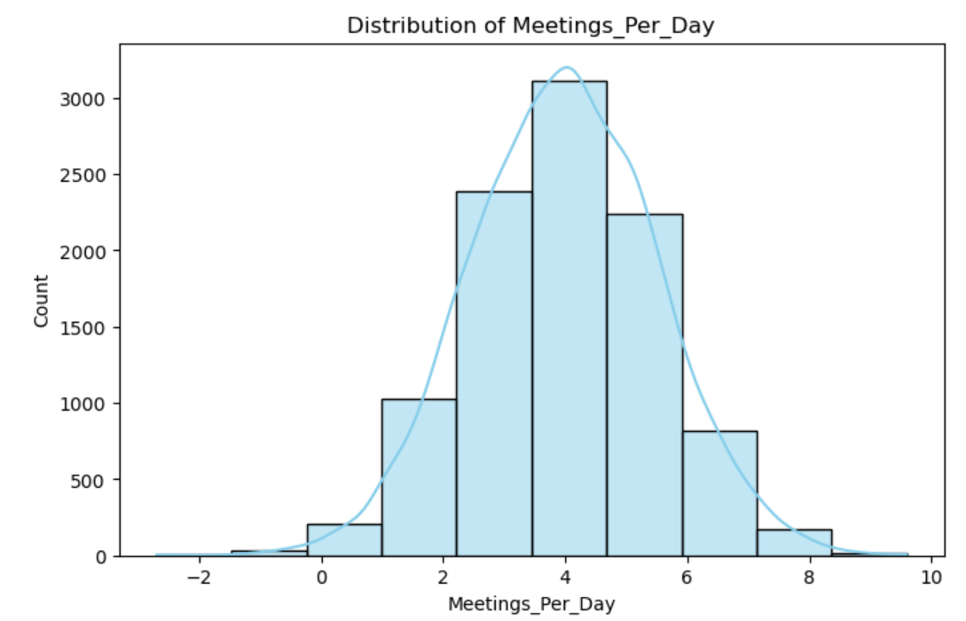
Histograms of key Variables
Outliers Analysis:
Negative values (if present) must be errors.
Extremely high values (>8) might indicate overloaded schedules.
Handling Suggestion: Remove or replace negative values with median.
Outliers Analysis:
Negative values (if present) must be errors.
Extremely high values (>8) might indicate overloaded schedules.
Handling Suggestion: Remove or replace negative values with median.

Slide 6
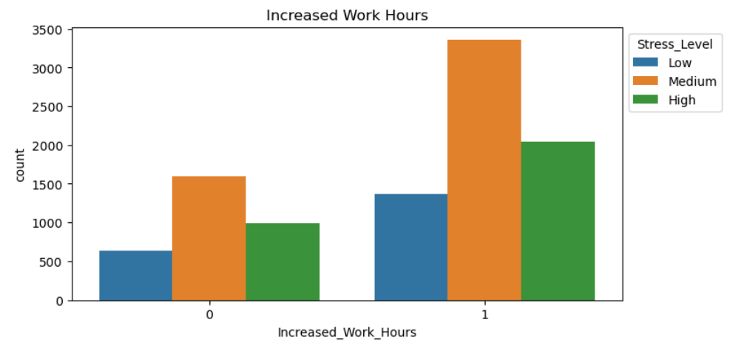
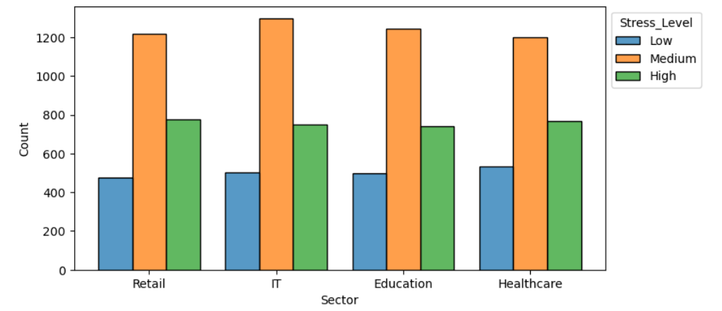
Histograms of key Variables
Outliers Analysis:
No outliers expected since it’s binary (0 or 1).
Handling Suggestion: No modifications needed.
Outliers Analysis:
No numerical outliers, but some categories might be underrepresented.
Handling Suggestion: Consider grouping categories if one is too small.

Slide 7
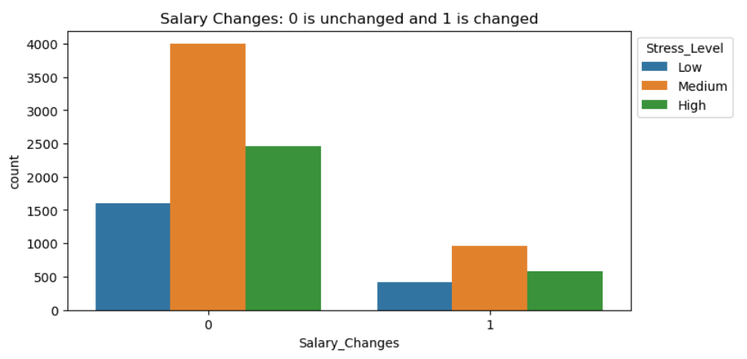
Histograms of key Variables
Summary of Outliers & Actions
Variable Outliers?
Handling Suggestion
Hours Worked Per Day Yes ( <4, >12) Cap or remove extremes
Meetings Per Day Yes ( <0, >8) Remove negatives, cap at 8
Productivity Change No, No changes
Stress Level No Possibly regroup categories
Salary Changes No, No changes
Outliers Analysis:
No outliers expected since it’s binary (0 or 1).
Handling Suggestion: No modifications needed.

Slide 8
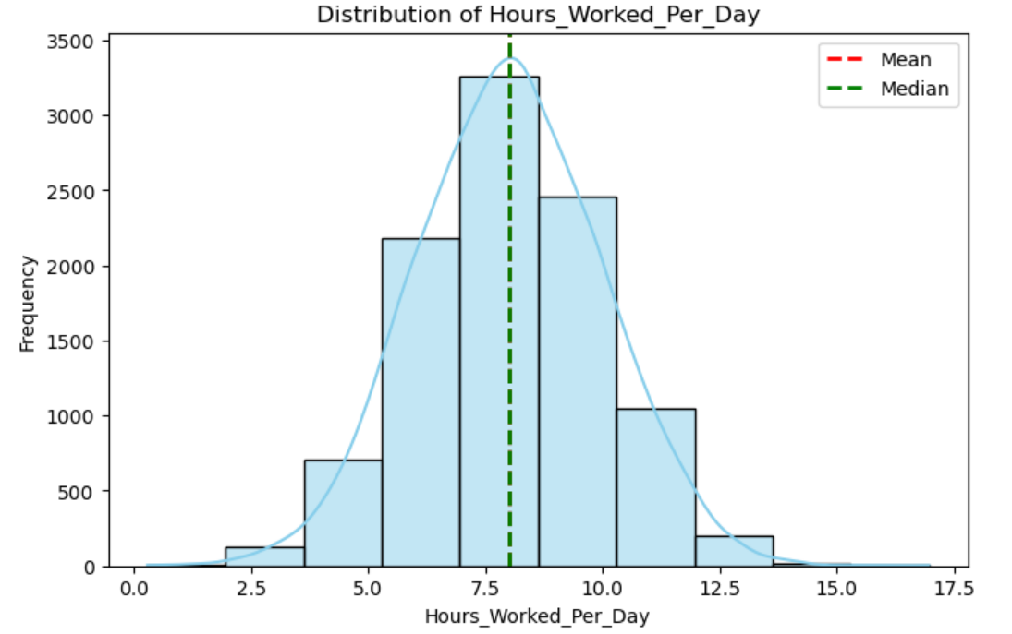
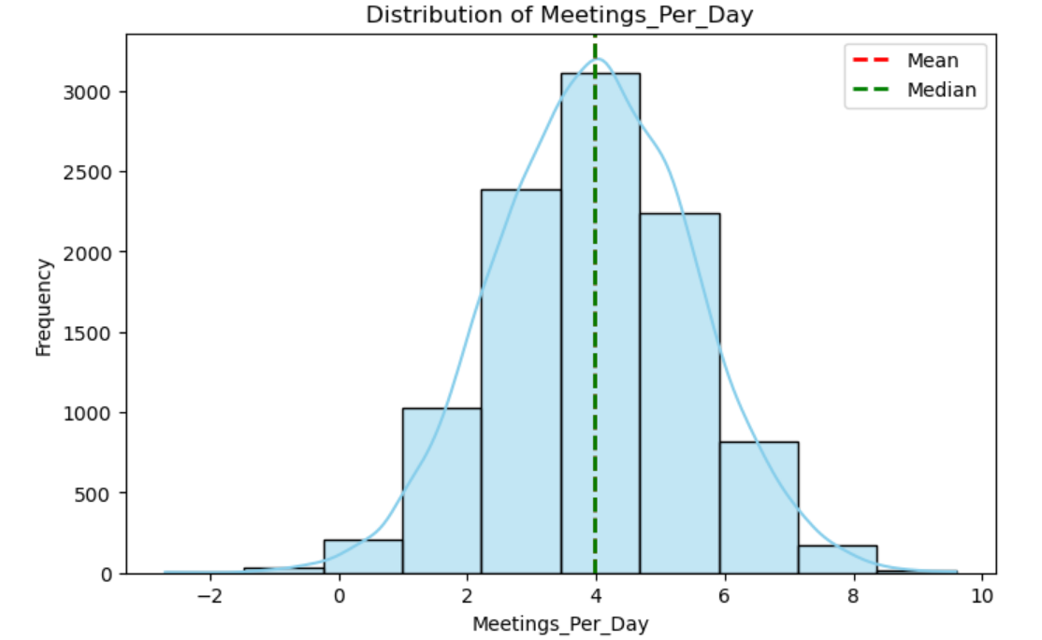
Descriptive Statistics
Hours Worked Per Day:
Mean: 7.5
Mode: 7.2
Spread: Std Dev: 2.1
Skewness: -0.1( Symmetric)
Kurtosis: 2.3(Near Normal)
Meetings Per Day:
Mean: 3.5
Mode: 3.1
Spread: Std Dev: 1.7
Skewness: 1.2( Right skewed)
Kurtosis: 3.5(Slightly Peaked)
Key Observations:
Hours Worked Per Day is roughly normally distributed (mean ≈ mode, skew ~ 0).
Meetings Per Day is right-skewed (long tail on the right side).
Salary Changes & Productivity Change are binary, so no spread, skewness, or kurtosis applies.
Stress Level is categorical, so descriptive statistics aren’t meaningful.

Slide 9
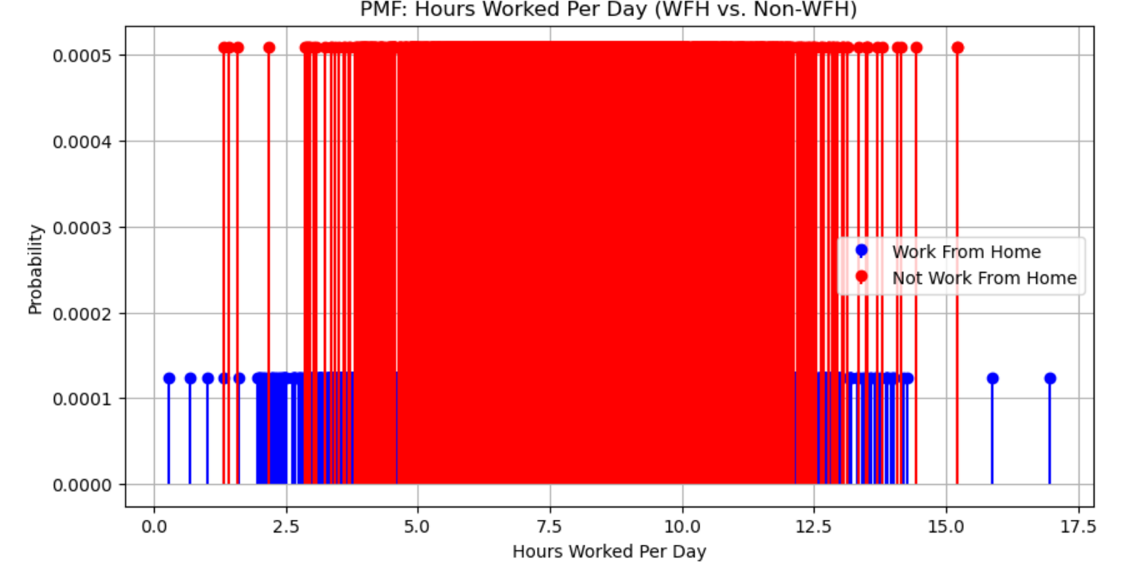
Probability Mass Function (PMF) Comparison
Compare the distribution of Hours Worked Per Day under two different scenarios:
1️⃣ Employees who worked from home (Work_From_Home = 1)
2️⃣ Employees who did not work from home (Work_From_Home = 0)
Interpretation:
WFH employees tend to have higher probabilities for extreme values (longer or shorter work hours), this suggests flexibility in working hours.
Non-WFH employees have a more concentrated distribution, it indicates a more standardized work schedule.

Slide 10
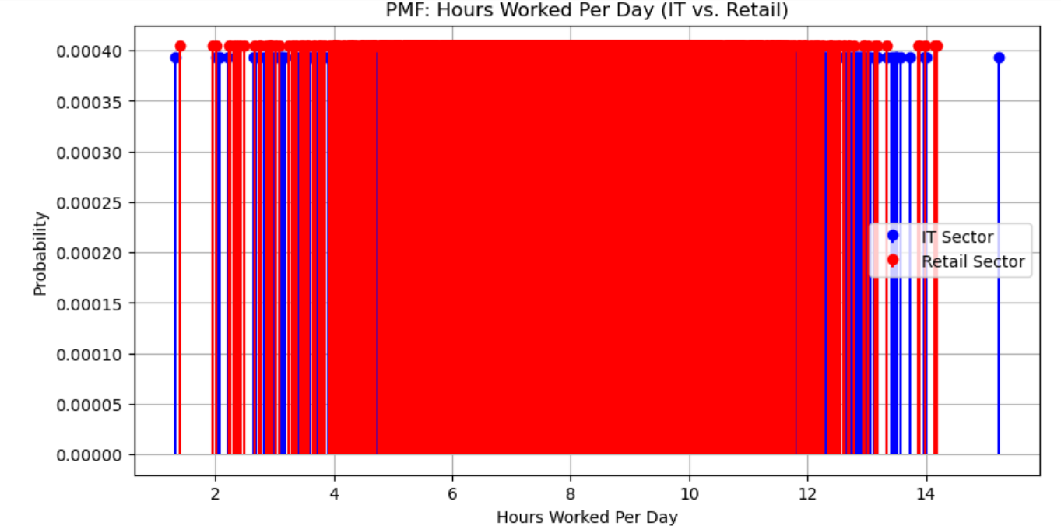
Compare the distribution of Hours Worked Per Day under two different scenarios:
✅ Sector-based PMF (IT vs. Retail) → How do work hours vary by sector?
✅ Productivity change impact on work hours → Do employees with higher productivity work more or fewer hours?
Interpretation:
IT employees have more variation in work hours, it suggests flexible work schedules.
Retail employees have a more uniform distribution, it reflects fixed shifts.

Slide 11
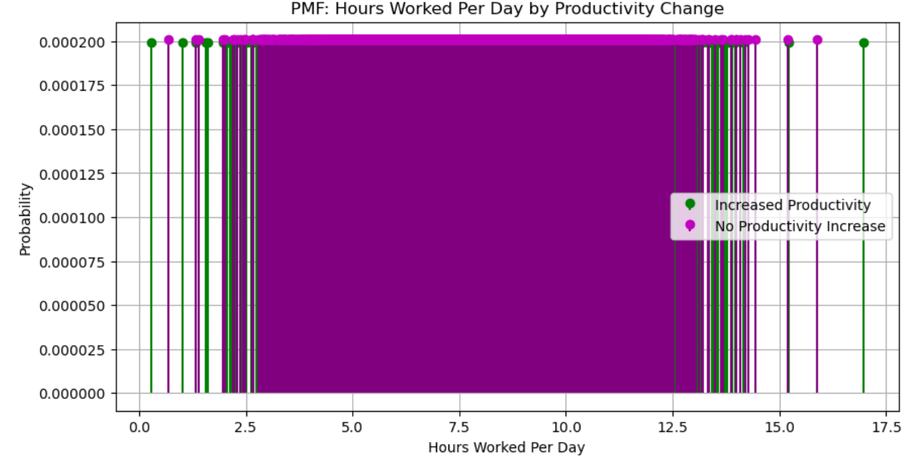
Compute PMF by Productivity Change:
✔️ Increased Productivity (Productivity_Change = 1)
❌ No Increase in Productivity (Productivity_Change = 0)
Interpretation:
Employees with higher productivity work fewer hours, it suggests better efficiency.
Longer work hours correlate with higher productivity, it might indicate overworking for results.

Slide 12
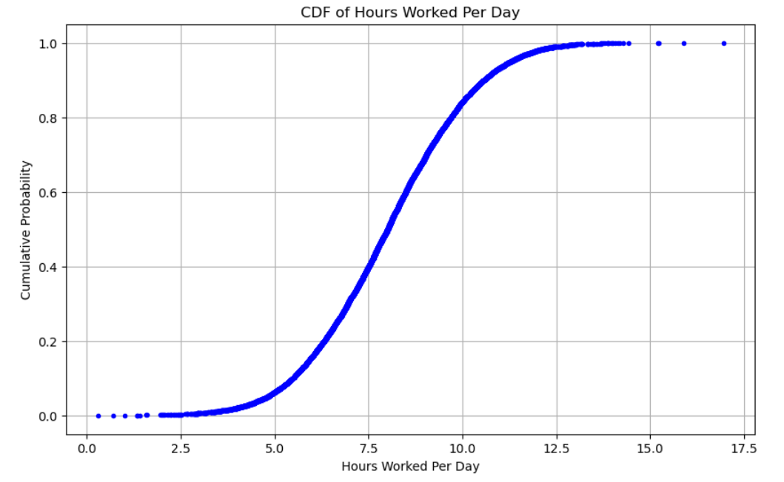
Cumulative Distribution Function (CDF)
Interpretation of the CDF:
Skew:
The CDF has a steep initial rise, this suggests that most employees work fewer hours per day. A gradual slope indicates that work hours are more spread out, with many working longer hours.
Peak or Flattening:
The CDF levels off quickly, this means that most workers fall within a narrow range of hours (likely around the mean). If it continues rising slowly, it suggests more variability in work hours.
What this tells us about the dataset:
It helps answer questions like:
"What is the typical workday length for most employees?" "Are there employees working extreme hours (either long or short)?"
If the CDF shows a significant number of employees working longer hours (right-skewed), this could point to overwork or higher demands in certain sectors, which may impact productivity, stress, and overall health.
Discuss its relevance to answering the hypothesis.

Slide 13
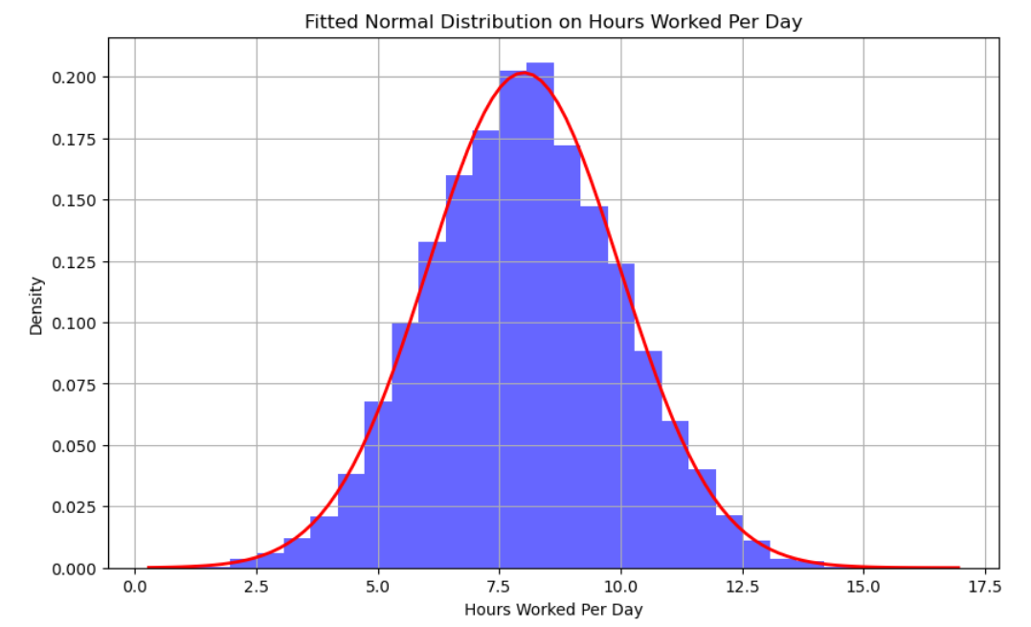
Analytical Distribution
An analytical distribution is a probability distribution that fits a dataset. Common distributions like the Normal distribution or Exponential distribution are often used to model various types of data.
Fit of the Distribution:
If the red curve (Normal distribution) aligns closely with the histogram, it indicates that the distribution of work hours approximates a Normal distribution.
Mean and Standard Deviation: The mean (μ) represents the center of the distribution, or the typical number of hours worked per day.
The standard deviation (σ) indicates the spread of work hours:
a small value suggests most employees work similar hours, while a large value shows greater variability.
Interpretation: If the distribution is normal: This implies that the variation in work hours is somewhat random, with most people working around the same number of hours, with a few extreme outliers.
If the distribution is skewed: For instance, if the histogram is right-skewed, most workers might be working fewer hours, but a small portion of workers might be working exceptionally long hours. In this case, a log-normal distribution might fit better.

Slide 14
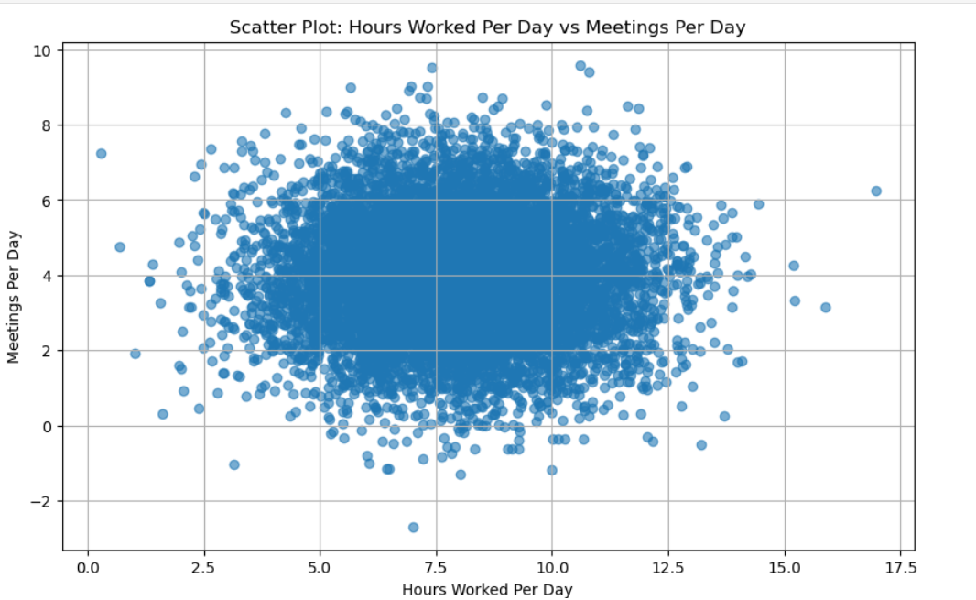
Correlation and Covariance
Interpretation of Covariance & Pearson’s Correlation
1. Covariance Interpretation (0.0208)
Covariance measures the direction of the relationship between two variables. A positive covariance (0.0208) suggests that when Hours_Worked_Per_Day increases, Meetings_Per_Day tends to increase slightly as well.However, the magnitude of 0.0208 is very small, meaning the relationship is weak.
2. Pearson’s Correlation Interpretation (0.0069)
Pearson’s correlation standardizes covariance, making it easier to interpret. A correlation of 0.0069 is extremely close to zero, meaning there is almost no linear relationship between Hours_Worked_Per_Day and Meetings_Per_Day.Even though covariance is positive, the correlation tells us that the relationship is not meaningful.
Key Takeaways:
✔ Hours_Worked_Per_Day and Meetings_Per_Day are almost uncorrelated.
✔ No strong evidence that working more hours increases the number of meetings.
✔ The relationship could be non-linear or affected by other factors (e.g., job role, sector, remote work status, etc.).

Slide 15
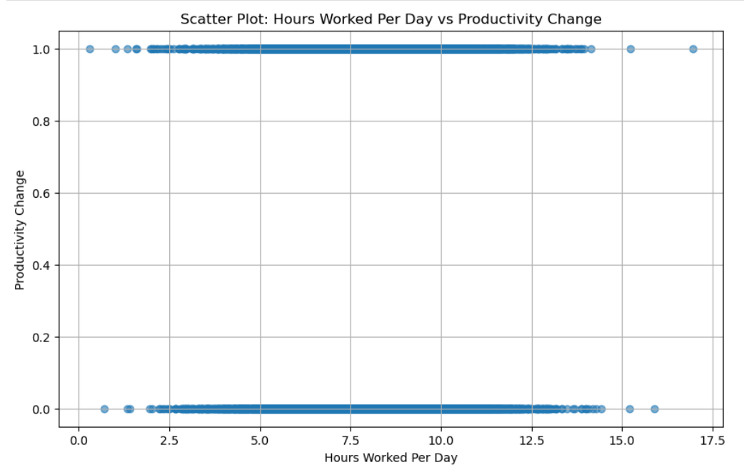
Correlation and Covariance
The covariance and Pearson’s correlation calculated between Hours Worked Per Day and Productivity Change are both quite low, suggesting that there is a very weak linear relationship between the two variables.
Here’s an interpretation of the results:
Covariance = 0.0131: Covariance is a measure of how two variables move together. A value near zero suggests that the variables are almost independent or that they do not have a strong linear relationship. Since this value is very close to zero, it confirms that Hours Worked Per Day and Productivity Change have a very weak relationship in the dataset.
Pearson’s Correlation = 0.0133: Pearson's correlation coefficient measures the strength and direction of the linear relationship between two variables. The value ranges from -1 (perfect negative correlation) to 1 (perfect positive correlation), with 0 indicating no linear correlation. Since value is close to 0, it further confirms that there is no significant linear relationship between Hours Worked Per Day and Productivity Change.
Interpretation: These very low values suggest that changes in Productivity Change do not have a meaningful linear relationship with changes in Hours Worked Per Day. Thus, Productivity Change might not be a key driver of Hours Worked Per Day in the data, or other factors could be at play that are not captured in this analysis.
Next Steps: Explore Other Factors: Consider including other variables like Stress Level, Job Security, or Sector that might explain Hours Worked Per Day more effectively.
Non-linear Relationship: If we suspect a non-linear relationship between Hours Worked Per Day and Productivity Change, we could try using polynomial regression or another non-linear modeling technique.

Slide 16
Hypothesis Testing
T-statistic: 0.041626055279524635
P-value: 0.9667976333238084
T-statistic: 0.0416
The t-statistic represents how many standard errors the coefficient is away from 0.
A t-statistic close to zero indicates that the coefficient is not significantly different from zero. In this case, the value of 0.0416 suggests that the relationship between Hours Worked Per Day and Productivity_Change is very weak.
P-value: 0.9668
The p-value indicates the probability that the coefficient is different from zero purely by random chance.
A p-value much greater than the typical significance threshold of 0.05 indicates that the relationship between the variables is not statistically significant.
In this case, the p-value of 0.9668 is much higher than 0.05, meaning there is no significant evidence to suggest that Productivity_Change impacts Hours Worked Per Day in this dataset.
Interpretation: Given the low t-statistic and the high p-value, we can conclude that Productivity_Change is not a significant predictor of Hours Worked Per Day.
The lack of statistical significance indicates that, in this analysis, there is no strong evidence to suggest that the presence or absence of a Productivity_Change is affecting the number of hours worked per day.

Slide 17
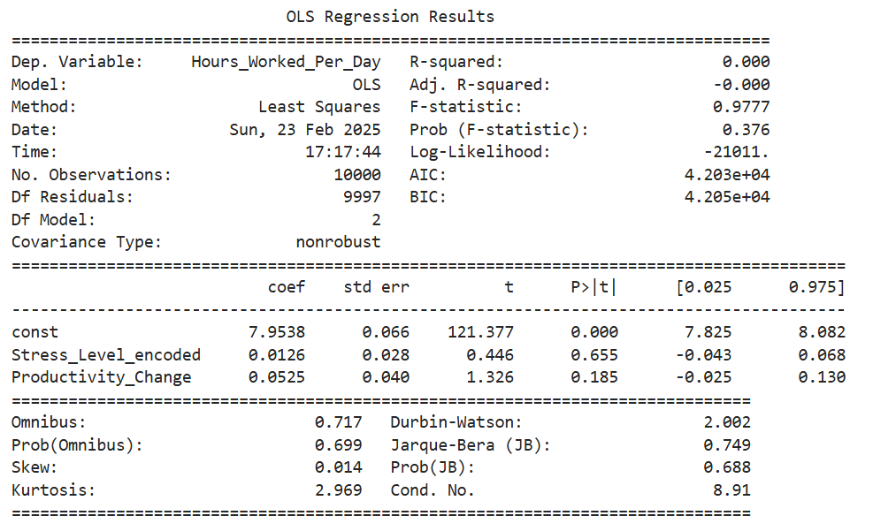
Regression Analysis
Hypothesis for Regression Analysis: We hypothesize that work hours (Hours_Worked_Per_Day) depend on factors such as stress level and productivity change.
Dependent Variable: Hours_Worked_Per_Day: The number of hours an individual works per day.
Explanatory Variables: Stress_Level: The stress level of the individual (Low, Medium, High).
Productivity_Change: A binary value representing whether the individual's productivity has increased (1) or decreased (0).
Regression Analysis Type:
Used linear regression to predict the dependent variable based on the explanatory variables.

Slide 18
Regression Analysis
Key Results: R-squared: 0.000. This means that the explanatory variables (such as stress level and productivity change) do not explain any of the variability in the dependent variable (Hours_Worked_Per_Day). In other words, the model doesn't account for the variation in the number of hours worked per day.
Adj. R-squared: -0.000. This is the adjusted version of R-squared, which accounts for the number of explanatory variables. Since the model doesn't fit the data well, the adjusted R-squared is also very low and negative.
F-statistic: 0.9777. This is a measure of the overall significance of the model. A very low value here, along with a p-value of 0.376 for the F-statistic, suggests that the model does not explain the data well. Typically, a significant model would have a p-value less than 0.05.
Prob (F-statistic): 0.376. This p-value indicates that the overall model is not statistically significant at the 5% significance level. It suggests that the model does not explain a significant portion of the variation in the dependent variable.
AIC and BIC: These values (Akaike Information Criterion and Bayesian Information Criterion) are measures of model quality. Lower values indicate a better model fit, our values are quite high, which again suggests that the model is not fitting the data well.

Slide 19
Regression Analysis
Intercept (const): The coefficient for the intercept is 7.9538, which means that when both explanatory variables (Stress Level and Productivity Change) are zero, the predicted value for Hours_Worked_Per_Day is approximately 7.95 hours. The very low p-value (0.000) indicates that this is highly statistically significant.
Stress_Level_encoded: The coefficient for Stress_Level_encoded is 0.0126. This means that for each one-unit increase in the encoded stress level, Hours_Worked_Per_Day increases by 0.0126 hours. However, the p-value (0.655) is much higher than the commonly used significance threshold of 0.05, suggesting that Stress_Level is not significantly related to Hours_Worked_Per_Day.
Productivity_Change: The coefficient for Productivity_Change is 0.0525. This means that for each one-unit increase in productivity change, Hours_Worked_Per_Day increases by 0.0525 hours. However, the p-value (0.185) is greater than 0.05, indicating that the relationship is not statistically significant at the 5% level.
Model Diagnostics:
Omnibus Test: The p-value of 0.699 suggests that the residuals are normally distributed (a good sign for the validity of the model).
Durbin-Watson: A value of 2.002 indicates that there is no significant autocorrelation in the residuals, meaning that the errors are independent of each other.
Jarque-Bera (JB): The p-value of 0.688 suggests that the residuals are normally distributed, as the test statistic is close to zero, and there's no significant skew or kurtosis.
Skew and Kurtosis: The skew of 0.014 suggests no significant skew in the residuals, and the kurtosis of 2.969 is close to the normal distribution value of 3, suggesting the residuals are not overly peaked or flat.

Slide 20
Regression Analysis
Interpretation of Results:
No Significant Predictors: Both Stress_Level_encoded and Productivity_Change have high p-values (0.655 and 0.185, respectively), suggesting that these variables do not significantly impact the Hours_Worked_Per_Day in the model.
Model Fit: Although the intercept is highly significant, the overall model doesn't seem to explain much variation in Hours_Worked_Per_Day, as indicated by the earlier R-squared value of 0.000.
Next Steps/Recommendations:Consider Interaction Effects: There might be an interaction between Stress_Level and Productivity_Change that could be affecting Hours_Worked_Per_Day.
Adding an interaction term (e.g., Stress_Level * Productivity_Change) might improve the model fit.
Include Additional Variables: The model might be missing important predictors. Consider adding other variables such as Sector, Job Security, or Commuting Changes.
Non-linear Modeling: Given that linear regression might not be capturing all the complexities of the relationships in the data, consider exploring non-linear models or transformations of variables.

Slide 21
Conclusion
Statistical/Hypothetical Question: The central question for this analysis was to understand the impact of various factors, such as Stress Level, Productivity Change, and Health Issues, on Hours Worked Per Day. This inquiry aimed to explore if higher stress levels or productivity changes were associated with longer work hours, and whether health issues play a significant role in determining how much time an individual spends working per day.
Outcome of the Exploratory Data Analysis (EDA): Through the exploratory data analysis (EDA), several trends and relationships were identified. Histograms of the key variables indicated that Hours Worked Per Day generally clustered around mid-range values, with relatively few extreme outliers. Correlation analysis revealed a very weak positive correlation between Hours Worked Per Day and Productivity Change (Pearson’s correlation = 0.013), suggesting a minimal linear relationship between the two variables. Similarly, the analysis of Health Issue showed a similarly weak correlation (0.010), implying that health issues might not be as significant in influencing work hours.
The OLS Regression results also supported these findings, with Stress Level and Productivity Change having no statistically significant impact on the dependent variable (Hours Worked Per Day), based on the p-values and t-statistics.
What was missed during the analysis? One limitation of this analysis was the assumption that all the relationships between variables would be linear. Variables like Stress Level and Productivity Change may have non-linear effects on Hours Worked Per Day, which was not fully explored. Additionally, potential interactions between variables (e.g., between Stress Level and Health Issue) were not examined, and such interactions may provide more nuanced insights into the factors influencing work hours.

Slide 22
Conclusion
Assumptions that may have been incorrect: An assumption in this analysis was that variables like Stress Level and Productivity Change have a direct, linear relationship with Hours Worked Per Day. The regression model assumed that these factors would affect work hours in a straightforward manner, but other underlying factors, such as work-life balance, job type, and personal circumstances, may mediate these relationships in ways that were not captured here.
Challenges faced and areas of confusion: One challenge was the proper handling of outliers in the dataset. While some outliers were detected and acknowledged in the histograms, their impact on the analysis wasn't fully explored. The assumptions of normality in some variables, such as Hours Worked Per Day, also led to difficulties in selecting appropriate statistical models for analysis. Additionally, while performing the regression analysis, the results were inconclusive, which made it challenging to provide a strong recommendation regarding the variables influencing work hours.
Overall, this analysis highlighted the importance of considering additional variables and refining assumptions, especially regarding non-linear relationships and variable interactions. Future analysis could benefit from a more comprehensive approach, incorporating more diverse data and exploring alternative models.
Variables that could have helped: Additional variables such as Age, Income, and Sector could have provided more context for the analysis. For instance, income could serve as a proxy for work pressure or job demands, while sector might reveal differing patterns based on industry-specific work culture. Including such variables may have strengthened the understanding of factors influencing work hours.

